Slide 1
Android calendar
Team-1
Alex Wimer
Connor Mahaffey
Theodore Sosnowski
Chris Wilson

Slide 2
Project Demo
View events
Monthly
Daily
Agenda
Add event
Single
Weekly
Monthly
Edit event
Change date
Change time
Change occurrence
Delete event

Slide 3

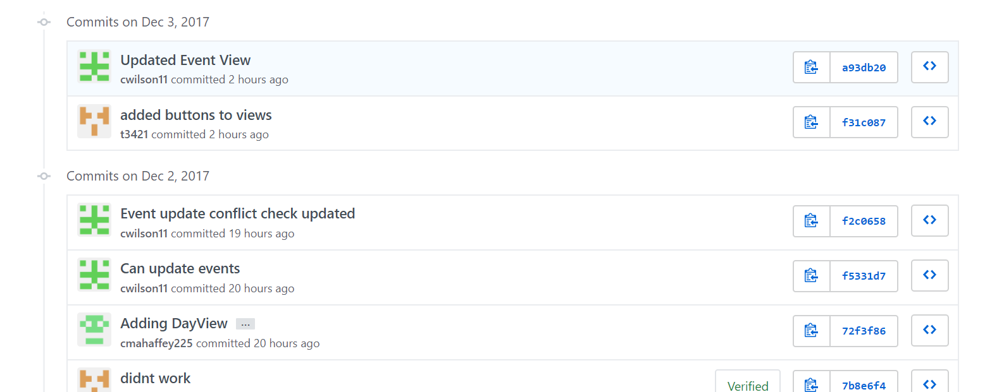
Commits

Slide 4
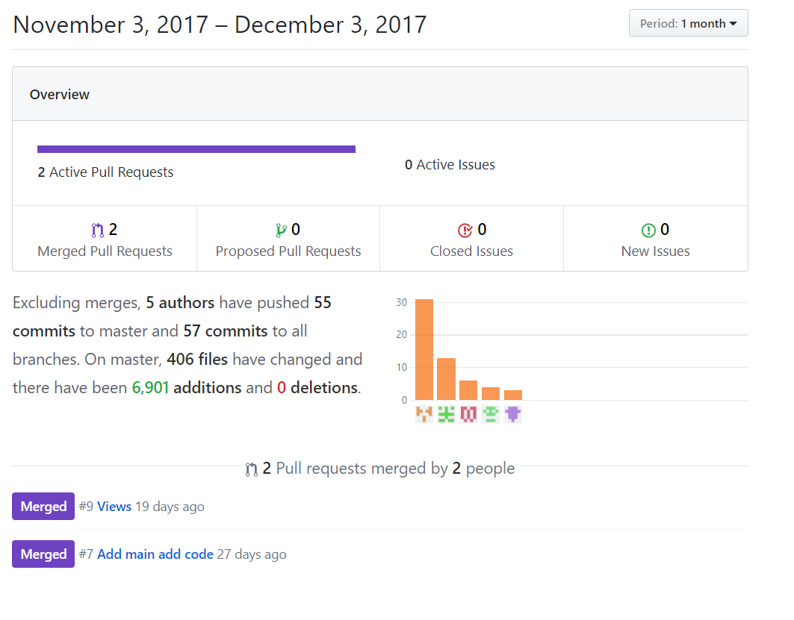
Insight

Slide 5
Team Organization
Team meetings
Meetings occurred after each class for updates
Once a month longer meetings pertain to the project
Communicated by text or in person
Task distribution
Appointment of task by group discussion and skill level

Slide 6
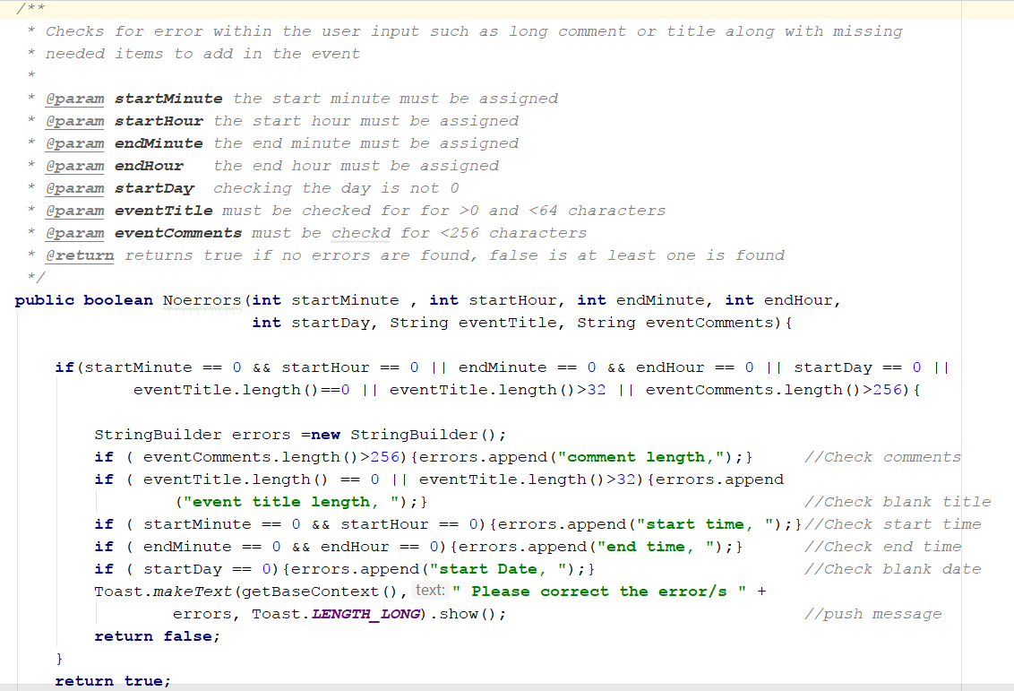
Coding Style and Comments
Link - http://www.oracle.com/technetwork/java/javase/documentation/codeconvtoc-136057.html
We tried to stick to the code convention linked above for oracle
Camel case style
Comments in code are used on a as needed basis for inside methods
Methods should all be commented on for use in Java Docs
Statements that need clarification or more guidance
Classes should all be commented on for use in Java Docs

Slide 7
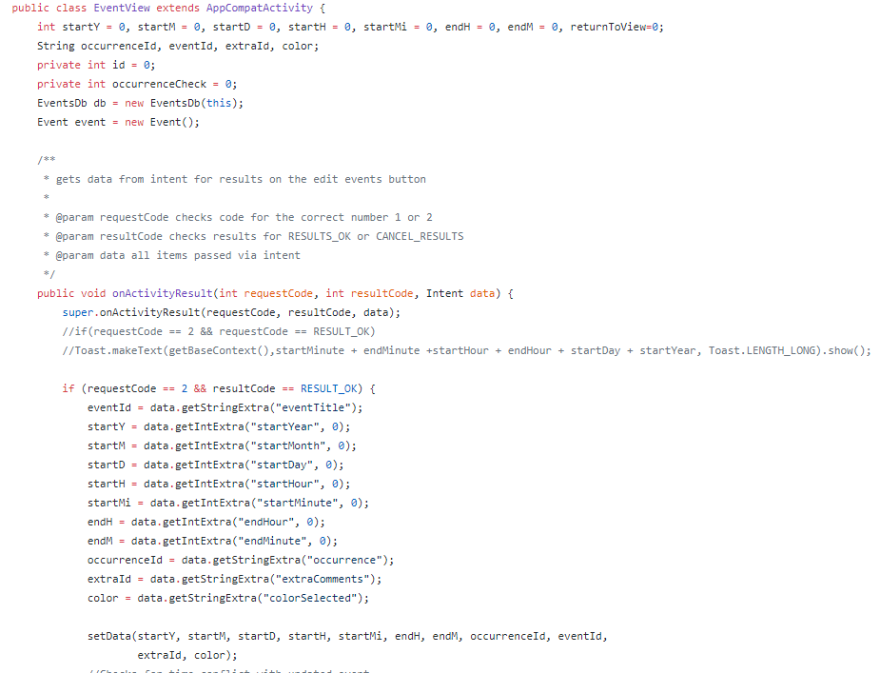
Design Pattern
Adapter Pattern
EventView adapts AppCompatActivity to give the database a usable interface

Slide 8
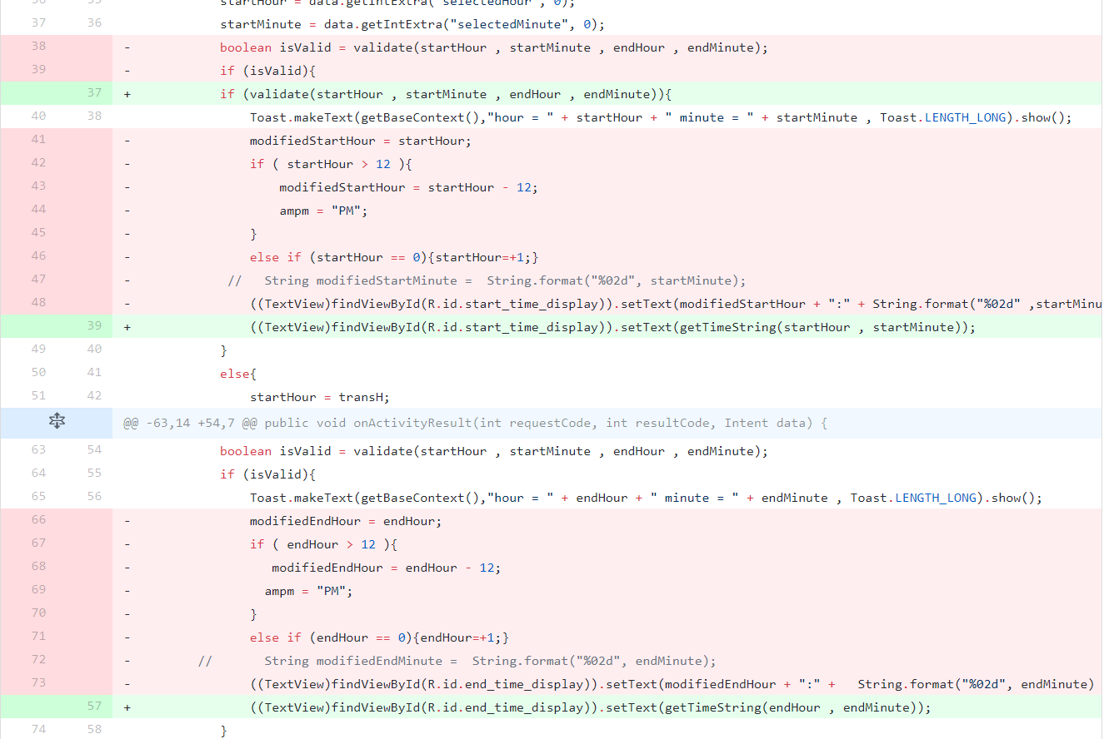
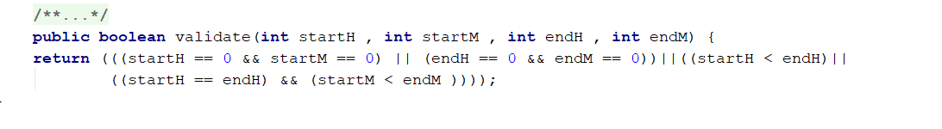
Refactoring
E M
X E
T T
R H
A O
C D
T
Before
After

Slide 9
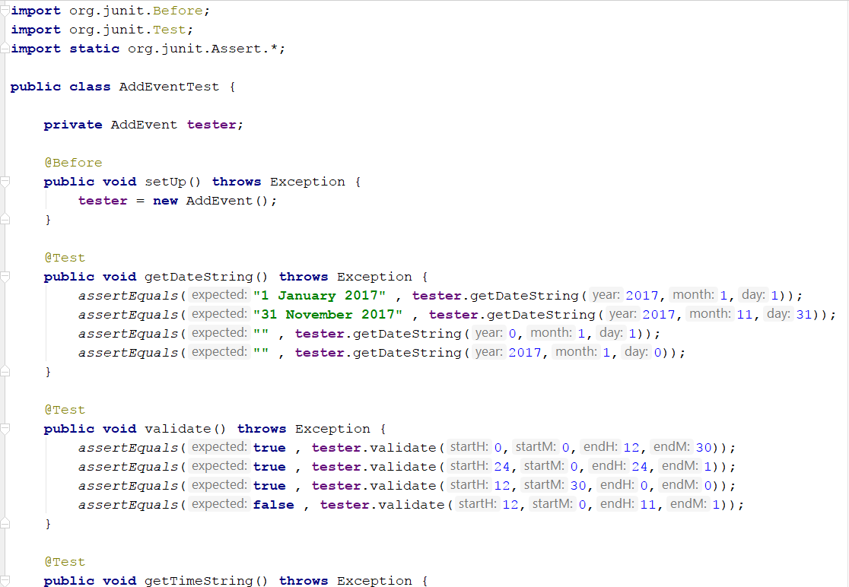
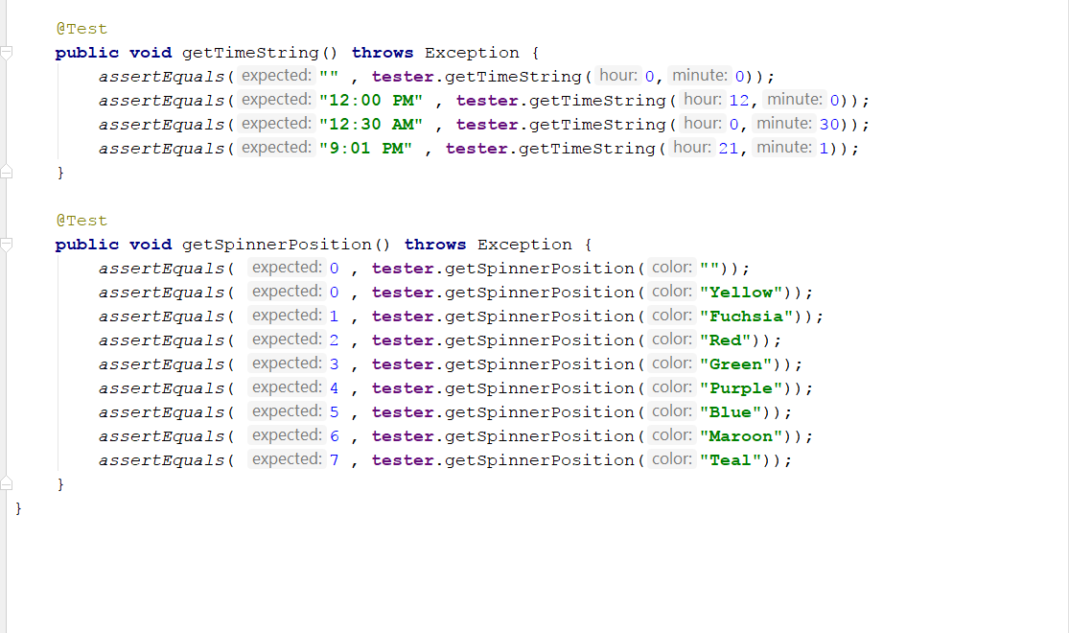
Testing
Test for add event class

